Slide 1
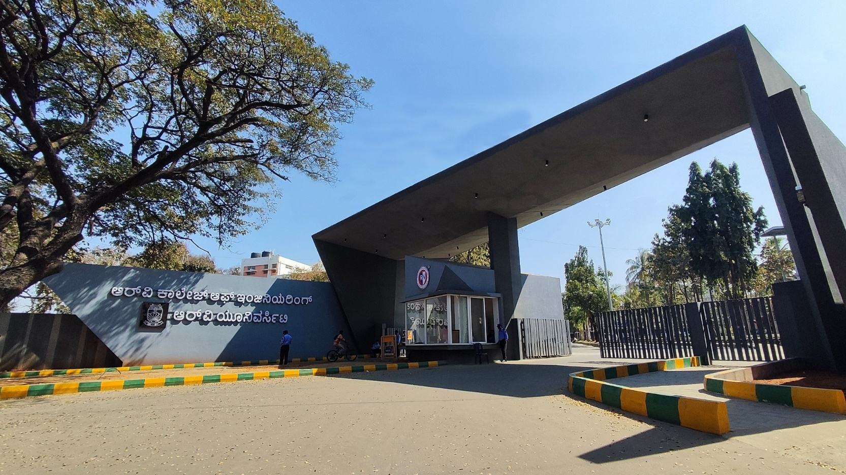
AI-Driven Battery Saver Kernel Module
Operating System – CS235AI

Slide 2


AI Driven Battery Saver Kernel Module
Janya Gupta
1RV24CS107
Kasvi Gupta
1RV24CS125

Slide 3
EL Phase-III
Presentation Outline
Introduction
Problem Statement
Objectives
Literature Review
Methodology
Design and Implementation
Components and Tools used
Results/Simulation
Challenges Faced
Final Outcome
Applications
Future Scope
Conclusion
References

Slide 4
Introduction
Overview of the topic:
Battery optimization is essential for modern operating systems.
Static power management techniques are inefficient under dynamic workloads.
Machine learning helps predict system stress using real-time metrics.
Process priorities are adjusted to reduce power consumption.
The system improves battery life while maintaining performance.

Slide 5
Problem Statement
Traditional operating system power management techniques rely on static policies that do not adapt to changing system workloads, leading to inefficient battery usage. There is a need for an intelligent OS-level solution that dynamically optimizes battery consumption based on real-time system conditions.

Slide 6
Objectives
To monitor real-time system parameters such as CPU utilization and process count.
To predict system stress using a machine learning–based approach.
To dynamically adjust process priorities for battery optimization.
To improve battery life while maintaining acceptable system performance.

Slide 7
Literature Review
Provide a brief overview of existing solutions or similar projects.
Mention key references or papers studied.
Explain how your project is different or an improvement over existing solutions.
SR.NO | JOURNAL NAME | DESCRIPTION/DETAILS | KEY POINTS | LITERATURE GAP
1. | AI-Based Power Management for Energy-Efficient Mobile Systems | DOI: https://www.sciencedirect.com/science/article/pii/S1574119225000343 | The paper presents an AI-driven power management framework that predicts application-level energy usage using machine learning models. Based on user behavior and system load, it dynamically allocates CPU, memory, and background process priorities to extend battery life. The system adapts in real time and improves energy efficiency without degrading performance. | The work is implemented at the software layer only. It does not integrate directly with the operating system kernel or use kernel-level modules for low-level power control.
 |  | Future Generation Computer Systems (Elsevier)
 |  | Rui Wang, Jie Liu, Yong Li, Xinyu Zhang
 |  | 2020
7

Slide 8
Literature Review
Provide a brief overview of existing solutions or similar projects.
Mention key references or papers studied.
Explain how your project is different or an improvement over existing solutions.
SR.NO | JOURNAL NAME | DESCRIPTION/DETAILS | KEY POINTS | LITERATURE GAP
2. | Energy-Aware Operating System Using Kernel-Level Power Management | DOI: https://www.sciencedirect.com/science/article/pii/S1877050921001095 | This paper proposes a kernel-level power management framework that dynamically adjusts CPU frequency, sleep states, and I/O scheduling. It reduces energy consumption by interacting directly with system hardware through kernel hooks and schedulers. | Although it is kernel-based, it does not use AI or predictive models. The system follows rule-based scheduling rather than intelligent learning-based optimization.
 |  | ACM Transactions on Embedded Computing Systems
 |  | Chen Wei, Park Minho, Li Sheng
 |  | 2022
Tuesday, 03 February 2026
Slide No. 8
8

Slide 9
Methodology
Continuously collect real-time system metrics including CPU utilization and process count.
Preprocess the collected data to normalize values for accurate analysis.
Apply a machine learning–based model to predict system stress levels.
Classify system state into different power modes based on defined thresholds.
Adjust process priorities dynamically using nice values to reduce power consumption.
Apply changes at the operating system level without modifying hardware.
Re-evaluate system conditions periodically to ensure adaptive battery optimization.

Slide 10
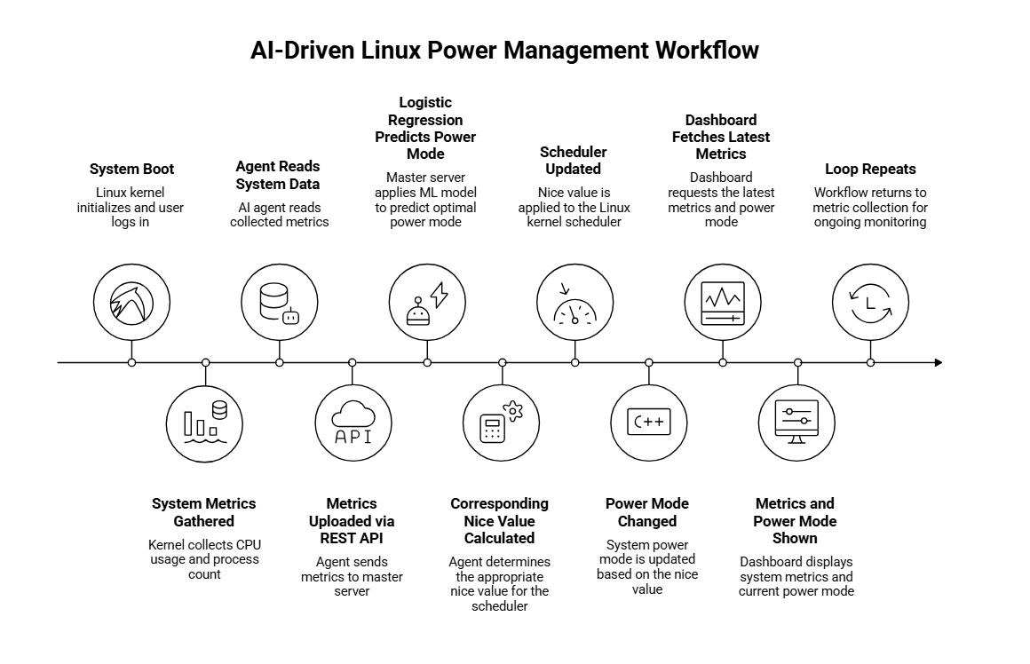
Figure 1 : Flowchart

Slide 11
Design and Implementation
The system is designed as a modular OS-level battery optimization framework.
A monitoring module collects CPU utilization and process count at fixed intervals.
A machine learning model analyzes the collected data to estimate system stress.
Power modes are defined based on stress thresholds for efficient battery usage.
Process priorities are adjusted using nice values according to the selected power mode.
The implementation runs in user space and interacts with the operating system scheduler.
The system operates continuously and adapts dynamically to workload changes.

Slide 12
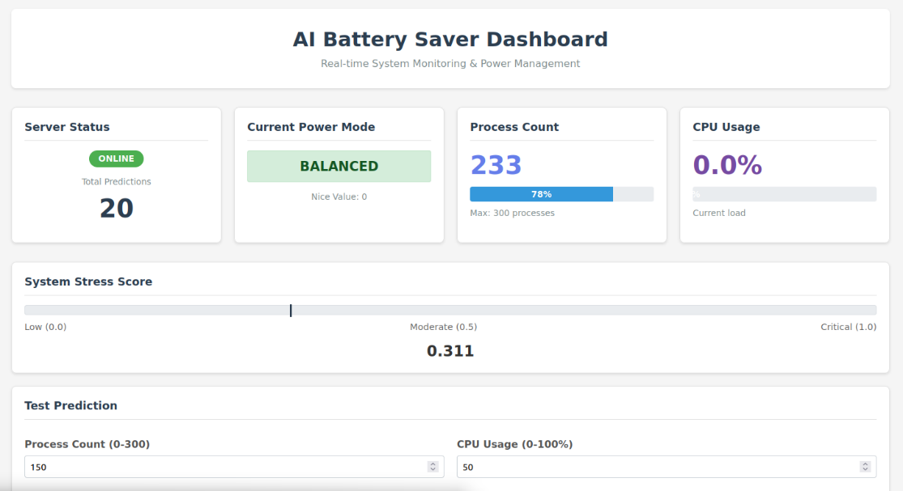
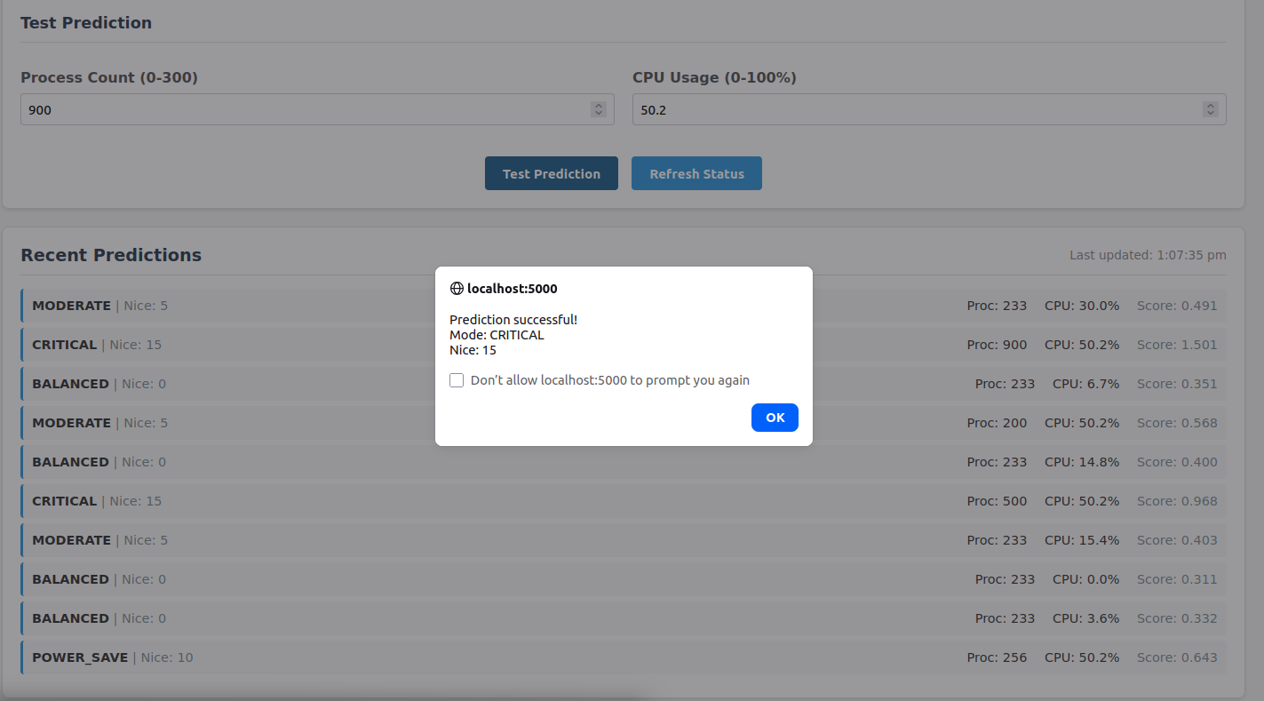
Design and Implementation
Figure 2: AI Battery Saver Dashboard
Figure 3: Power Mode Prediction Interface

Slide 13
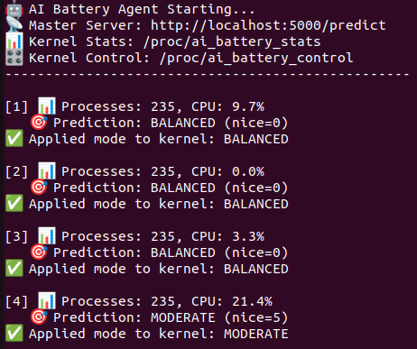
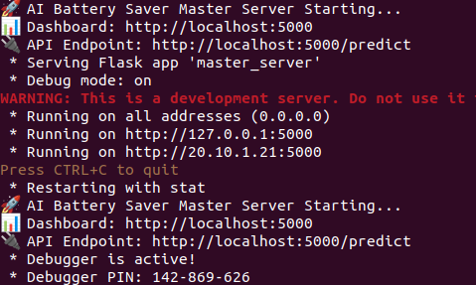
Design and Implementation
Figure 4 : AI Battery Saver Backend Terminals

Slide 14
Components and Tools Used
Linux operating system
Python for system monitoring and control
Machine learning model (Logistic Regression)
System utilities for CPU and process monitoring
nice command for priority adjustment

Slide 15
Results/Simulation
System metrics were monitored accurately in real time.
Stress levels were classified correctly into power modes.
Process priorities were adjusted dynamically using nice values.
Background processes were throttled during high load.
Smooth transitions were observed between power modes.

Slide 16
Challenges Faced
Selecting suitable threshold values for power modes
Maintaining system responsiveness while saving power
Accurate stress prediction under fluctuating workloads
Avoiding excessive priority changes

Slide 17
Final Outcome
Developed an adaptive OS-level battery optimization system.
Machine learning improved workload-based decision making.
Dynamic priority control reduced unnecessary power usage.
No hardware modification or kernel changes were required.
System maintained performance while saving battery.

Slide 18
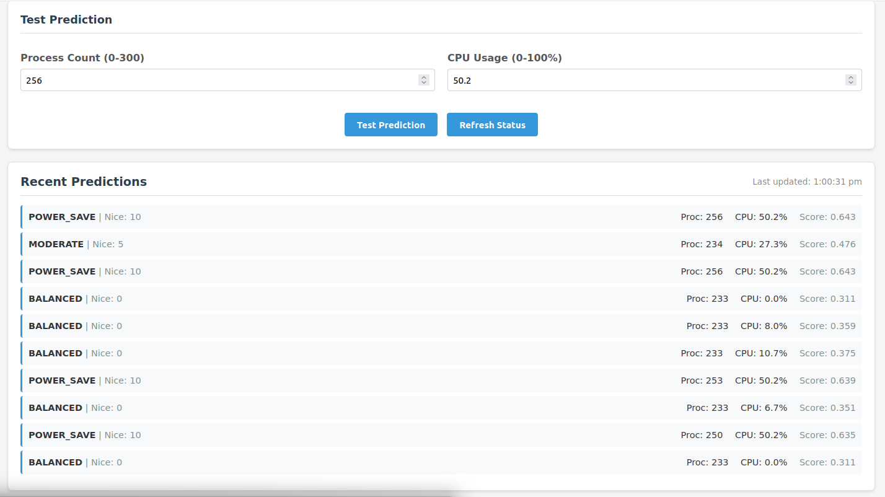
Final Outcome
Figure 5: Power Mode Prediction Interface

Slide 19
Applications
Laptops and portable computing devices
Battery-powered embedded Linux systems
Energy-aware operating system research
Performance-sensitive mobile platforms

Slide 20
Future Scope
Integration with real-time battery health metrics
Use of advanced machine learning models
Kernel-level implementation for deeper optimization
Extension to GPU and memory power management

Slide 21
Conclusion
The project demonstrates an effective OS-level battery optimization approach using machine learning and dynamic process priority control. By adapting to real-time workload conditions, the system reduces power consumption without compromising system performance. The results highlight the advantage of intelligent and adaptive power management over traditional static techniques.

Slide 22
Acknowledgments
We would like to express our sincere gratitude to our project guide for their continuous guidance, valuable suggestions, and encouragement throughout the project. We also thank the faculty members of the department for their support and constructive feedback. Finally, we acknowledge our institution for providing the necessary resources and environment to successfully complete this project.

Slide 23
References
[1]Wang, R., Liu, J., Li, Y., & Zhang, X. (2020). AI-based power management for energy-efficient mobile systems. Future Generation Computer Systems, Elsevier.
[2] Mishra, S., Verma, A., & Kumar, R. (2021). Machine learning–driven battery optimization in Android systems. IEEE Access.
[3]Wei, C., Minho, P., & Sheng, L. (2022). Energy-aware operating system using kernel-level power management. ACM Transactions on Embedded Computing Systems.
[4] Linux Manual Pages – nice, top, ps, and system monitoring utilities.
[5] Scikit-learn Documentation – Logistic Regression Model.

Slide 24


